Slide 1

House Price Prediction using Regression Models
A Machine Learning Project | MSBA | Python | Scikit-learn
Presented by: Srinivas Bhootam | MSBA Candidate 2025

Slide 2




Project Objective
Build Accurate Models
Structured Data Utilization
Predict residential property prices effectively.
Use a real estate dataset with rich features.
End-to-End Workflow
Cover data prep, EDA, modeling, and evaluation.

Slide 3


Dataset Overview
Size
~93,000 rows
Key Features
Carpet Area, Bathroom Count, Location, Property Status
Additional Features
Floor Info, Ownership Type, Furnishing, Facing, Transaction Type, Price per Sq.Ft, Total Amount
Target Variable
Price (in rupees)

Slide 4




Preprocessing & EDA
Data Cleaning
Missing values handled, irrelevant fields dropped.
Feature Engineering
Categorical features encoded, area metrics normalized.
Exploratory Visuals
Price distribution, Carpet Area vs Price, Correlation heatmap analyzed.

Slide 5
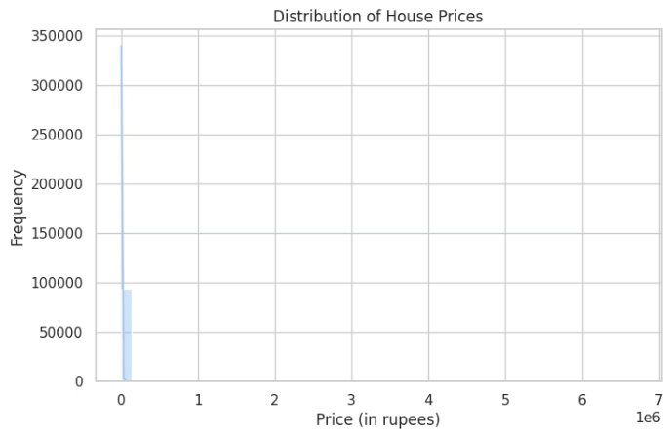
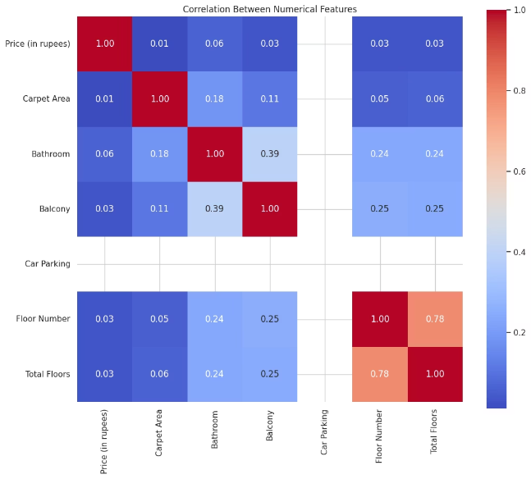
Exploratory Data Analysis
Price Distribution: Highly skewed, most houses priced in the lower range.
Correlations: Weak individual correlation with price; bathroom count shows the strongest among them.

Slide 6
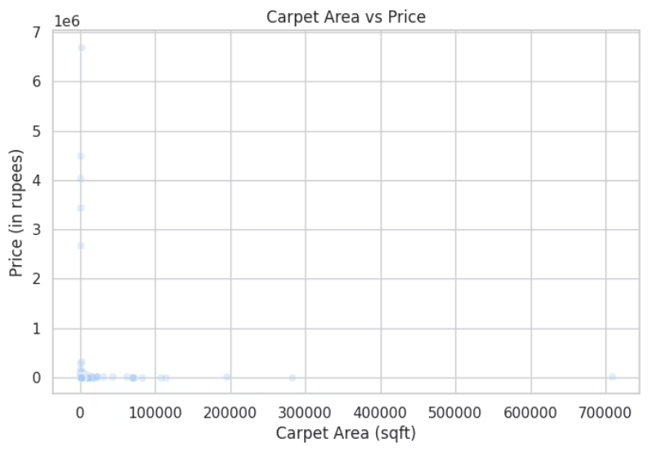
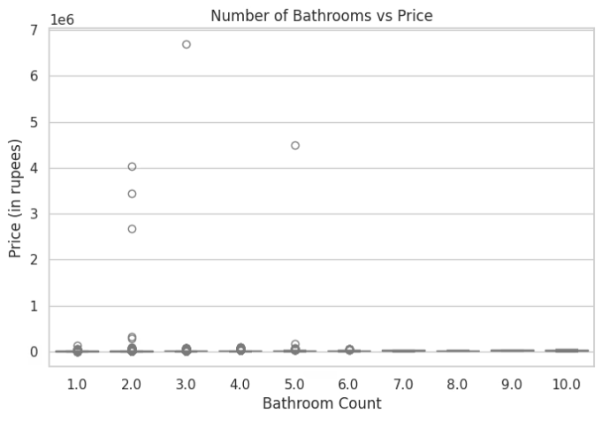
Feature vs Price Relationships
Carpet Area vs Price: Shows a weak positive trend with significant outliers; higher area doesn’t always mean higher price.
Bathroom Count vs Price: Slight upward trend, but most prices remain concentrated at lower values regardless of bathroom count.

Slide 7




Regression Models Used
Linear Regression
Basic linear relationship modeling.
Ridge Regression
Linear with L2 regularization.
Polynomial Regression
Degree 2 for non-linear patterns.
These models were implemented using scikit-learn for robust performance.

Slide 8

Model Evaluation
MAE
RMSE
Average Error
Large Error Penalty
Mean Absolute Error measures average prediction accuracy.
Root Mean Squared Error penalizes larger errors more heavily.
MSE
Squared Error
Mean Squared Error quantifies average squared difference.

Slide 9
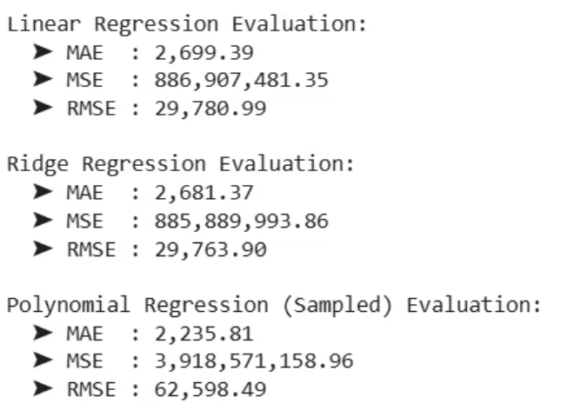
Key Takeaways
Polynomial Regression
Ridge Regression
EDA Insights
Lowest MAE
Balanced results
No single strong predictor
High RMSE (overfitting)
Improved generalization
Multifeature models essential

Slide 10


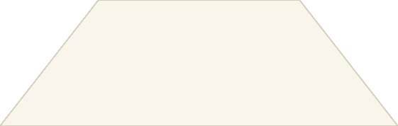

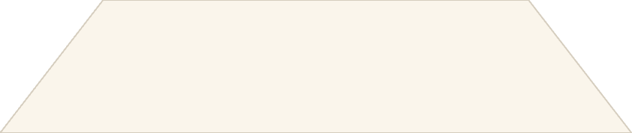

Conclusion
Ridge Regression
Consistent and stable for deployment.
Polynomial Regression
High error variance, unreliable.
Value of Regularization
Crucial for real-world forecasting tasks.
Ridge Regression balances complexity and generalization, making it ideal for robust house price prediction.

Slide 11

Tools & Technologies
Python
Google Colab
Primary programming language
Cloud-based development environment
Key Libraries
Other Tools
scikit-learn
GitHub (Version Control)
pandas
Markdown + GitHub Pages (Reporting)
matplotlib
seaborn

Slide 12

Thank you
Srinivas Bhootam | Data & Analytics Enthusiast
srinivas.bhootam@gmail.com

